Slide 1
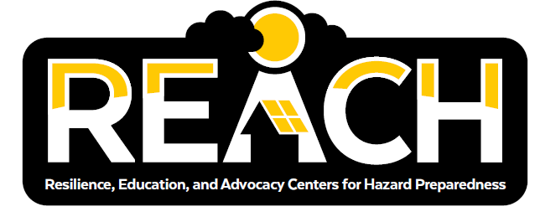
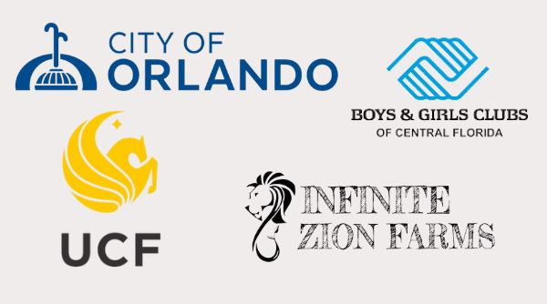

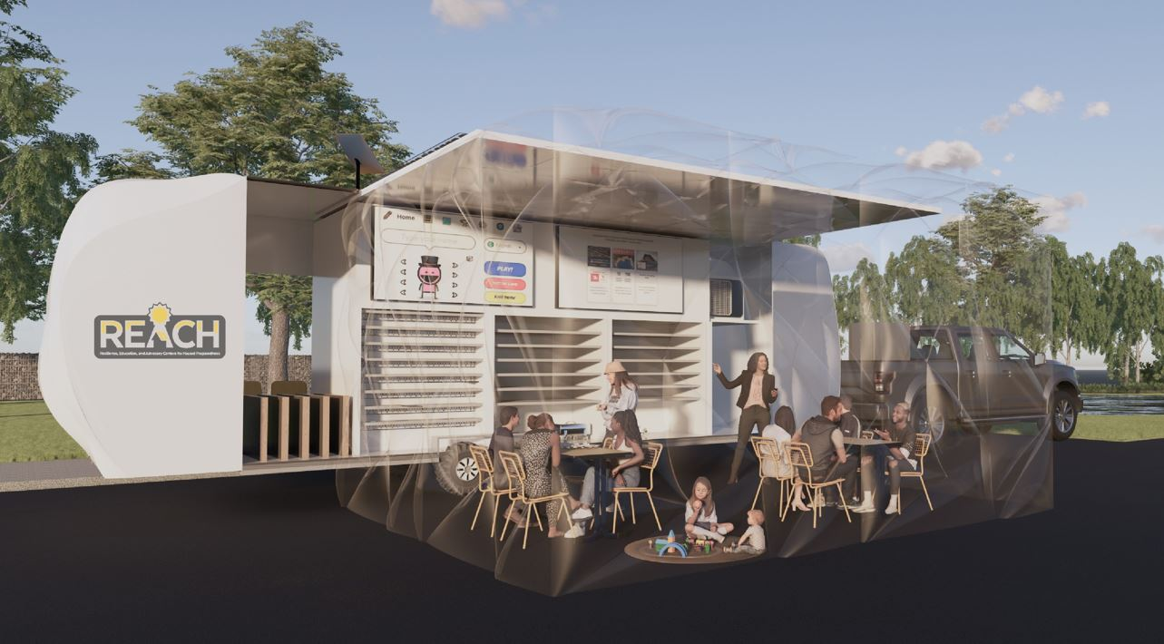
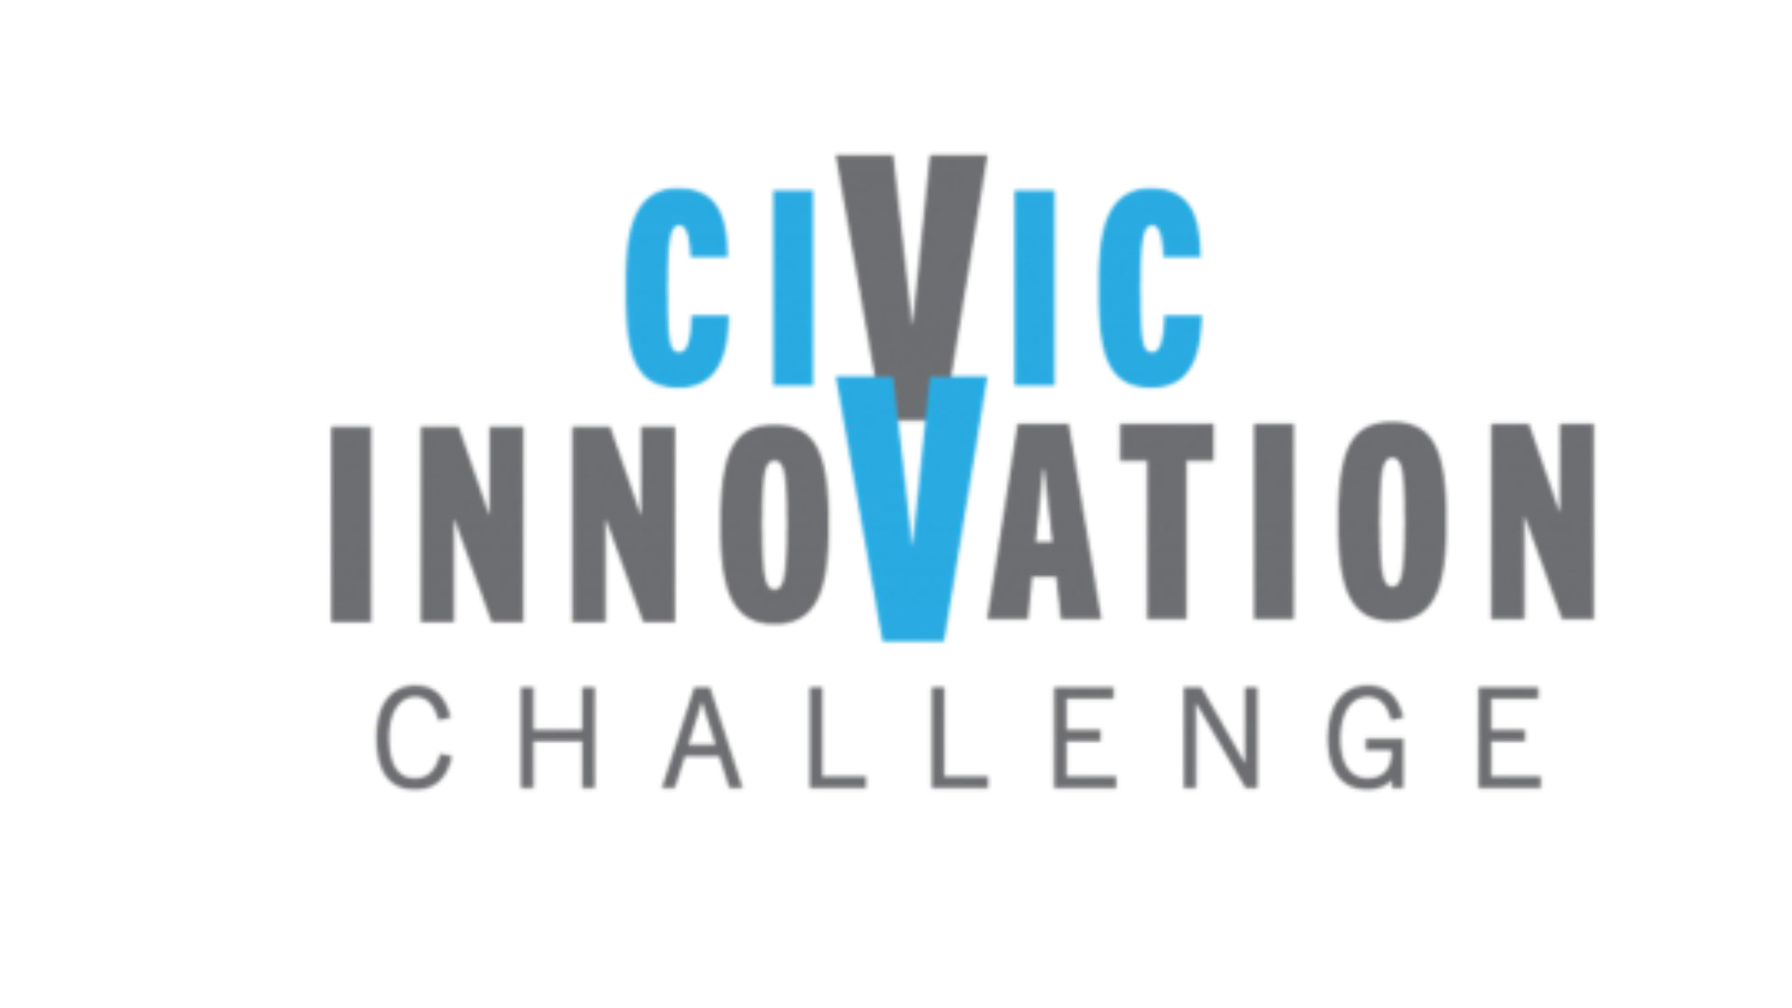
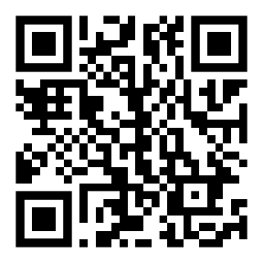


Reimagining Urban Resilience and Education Hubs Using a Community-Engaged, Equity-Centered Approach
Pilot Location: Orlando, FL
NSF Award ID: 2321572
PI: Kelly A. Stevens,
University of Central Florida
Project Challenge
The City of Orlando has identified a recurring need for equitable resilience to enhance Orlando’s ability to deliver efficient and secure public services, such as reliable electricity and internet connectivity. Climate change is exacerbating the frequency and severity of extreme weather events that disproportionately impact historically marginalized communities. The Resilience, Education, and Advocacy Center for Hazard preparedness, or REACH hub designed in this project will provide pre- and post-disaster necessities and connectivity and serve as hands-on STEM education centers during non-emergency times.
Research Questions
What are the benefits of a localized resilience hub for historically marginalized community members?
What are the key attributes of a portable, scalable, and modular hub design so it can easily be used by the community?
Core Civic Partners:
City of Orlando (M. Hess)
U.S. Green Building Council (I. Lahiff)
Boys & Girls Clubs of Central Florida Levy-Hughes Clubhouse
Hebni Nutrition Consultants
Pilot Vision
Build 1 pilot REACH hub using design from NSF CIVIC Stage 1 below.
Conduct 4 test-run demonstrations at 2 community partner locations: Boys & Girls Clubs of Central Florida Levy-Hughes Clubhouse and one other location during “blue” and “gray” skies.
Research Partners:
UCF: School of Public Administration (K. Stevens, Y. Ge, C. Emrich, M. Concha), Electrical and Computer Engineering (Z. Qu), Learning Sciences and Educational Research (L. T. Marsh), Computer Science (L. Wang), Materials Science (K. Davis)
REACH hub design: Portable, solar powered hub with device charging, broadband internet, display screens, hazard and STEM learning stations, freezer, refrigerator, and inflatable cooling tent using hybrid AC/DC power distribution system.
More Information
Visit our project website: https://rises.research.ucf.edu/nsf-civic/
Or contact Kelly Stevens, at Kelly.Stevens@ucf.edu
2022 Civic Innovation Challenge

